Slide 1



UNIVERSITY INSTITUTE OF ENGINEERING
COMPUTER SCIENCE ENGINEERING
Bachelor of Engineering
Design and Analysis of Algorithms(CST-311/ITT-311)
Topic: Sorting algorithm In Linear Time
( Counting and Radix sort)
DISCOVER . LEARN . EMPOWER

Slide 2
Learning Objectives & Outcomes
Objective:
To understand Sorting algorithm In Linear Time
Outcome:
Student will understand Sorting algorithm In Linear Time.

Slide 3
Counting Sort
Counting sort is a stable sorting technique, which is used to sort objects according to the keys that are small numbers. It counts the number of keys whose key values are same. This sorting technique is effective when the difference between different keys are not so big, otherwise, it can increase the space complexity.

Slide 4
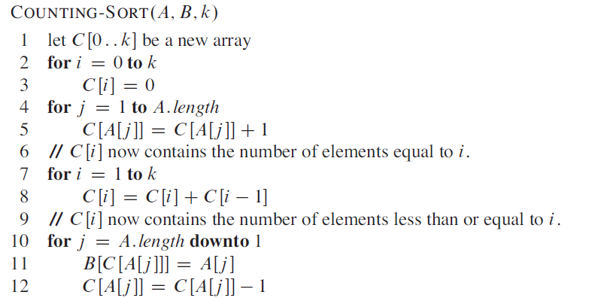
Counting Sort: Algorithm

Slide 5
Radix Sort
Radix sort is a sorting technique that sorts the elements by first grouping the individual digits of the same place value. Then, sort the elements according to their increasing/decreasing order.
Suppose, we have an array of 8 elements. First, we will sort elements based on the value of the unit place. Then, we will sort elements based on the value of the tenth place. This process goes on until the last significant place.

Slide 6
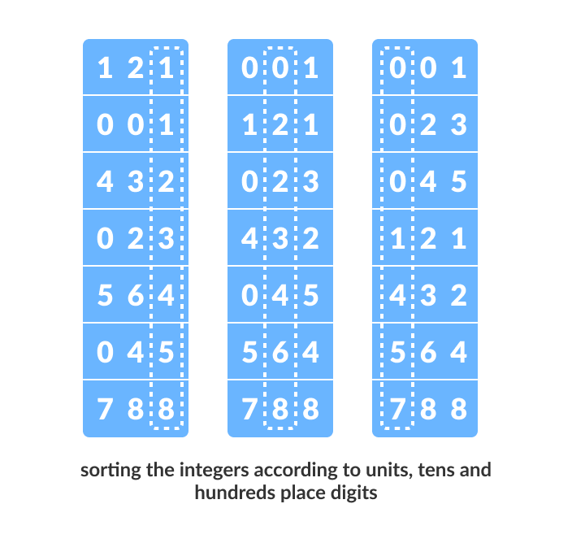
Radix Sort (Contd…)
Let the initial array be [121, 432, 564, 23, 1, 45, 788]. It is sorted according to radix sort as shown in the figure below.

Slide 7
Radix Sort (Contd…)
The Radix Sort Algorithm
1) Do following for each digit i where i varies from least significant digit to the most significant digit.
a) Sort input array using counting sort (or any stable sort) according to the i’th digit.

Slide 8
REFERENCES
Text books:
Cormen, Leiserson, Rivest, Stein, “Introduction to Algorithms”, Prentice Hall of India, 3rd edition 2012. problem, Graph coloring.
Horowitz, Sahni and Rajasekaran, “Fundamentals of ComputerAlgorithms”, University Press (India), 2nd edition
Websites:
https://www.geeksforgeeks.org/counting-sort/
https://www.programiz.com/dsa/radix-sort

Slide 9
Summary
Sorting Algorithm in Linear Time
  Radix Sort
  Counting Sort

Slide 10
THANK YOU

